Slide 1
SMART HOME SYSTEM
Group name; Team 6
George Izuchukwu Enekewa
Patrick Nonki
Habeeb Riwan Giwa

Slide 2
APPLICATION FUNCTIONS OF THE SMART HOME DEVICES
01
Bluetooth where LED lights are connected locally in a short range.
02
LDR or Photoresistor to control when the light should be Turned On or Off.
03
GSM Module System in connection with window blinds.
George Izuchukwu Enekwa
Habeeb Riwan Giwa
Patrick Nonki

Slide 3
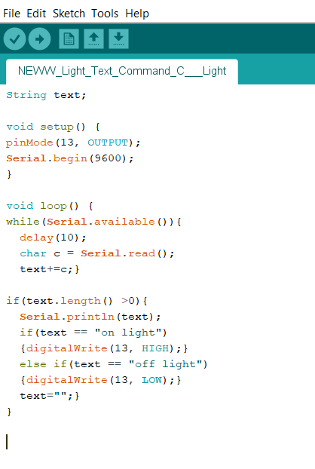
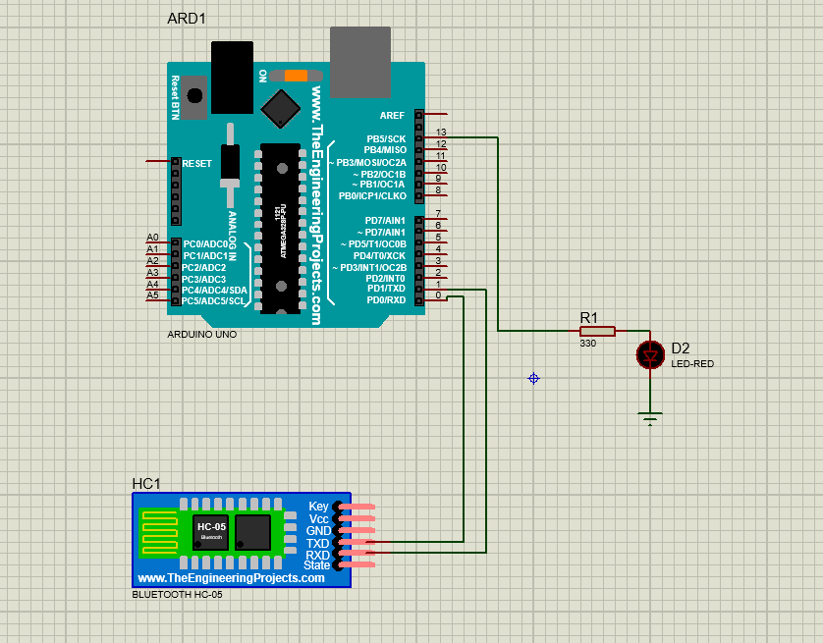
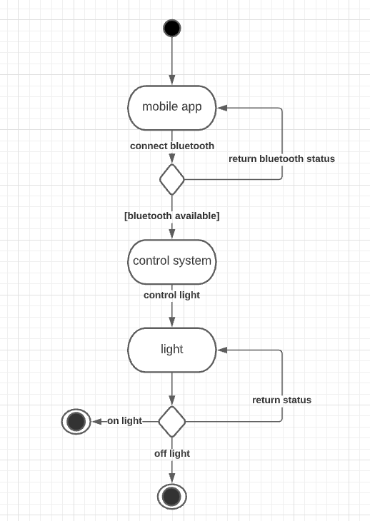
Bluetooth controlled LED Light
State Machine diagram
Simulation Connection
George Izuchukwu Enekwa

Slide 4
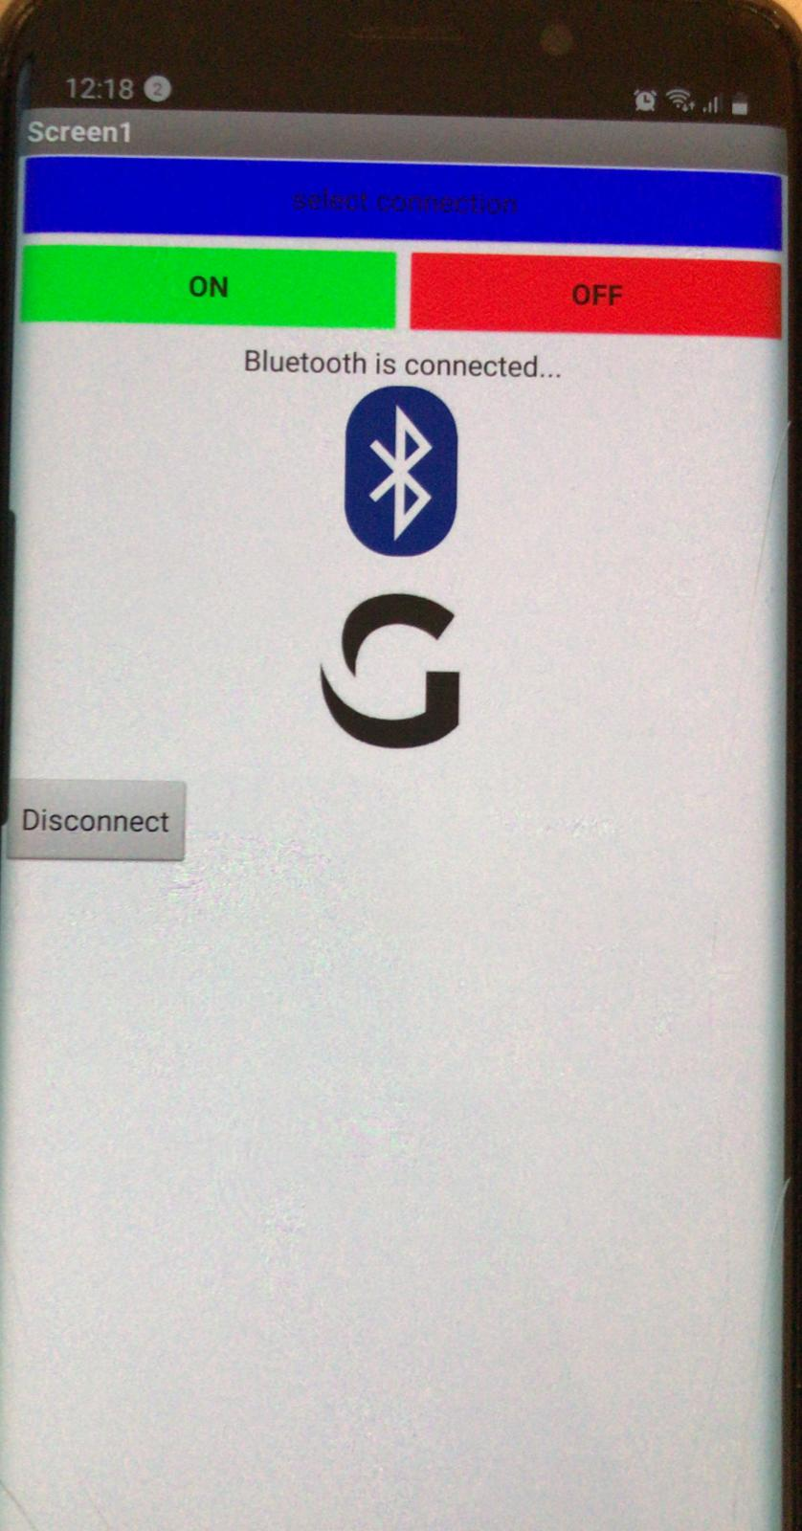
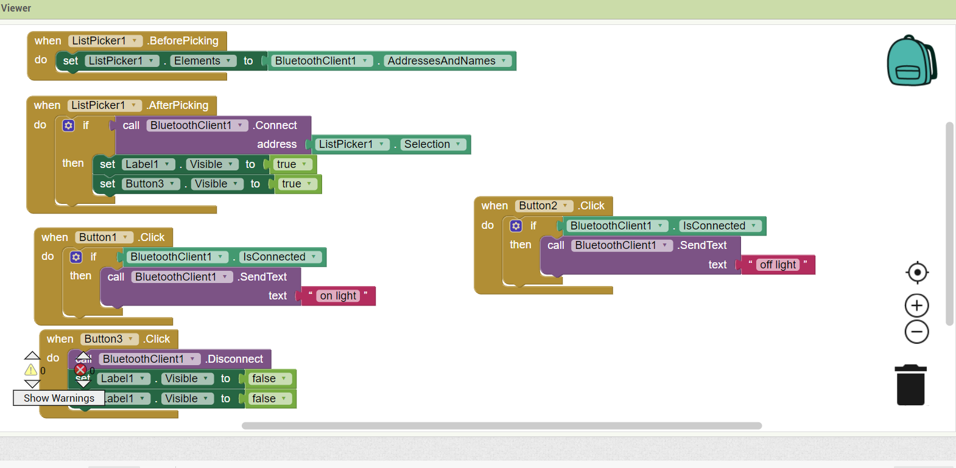
Bluetooth controlled LED Light (CODES)
George Izuchukwu Enekwa

Slide 5
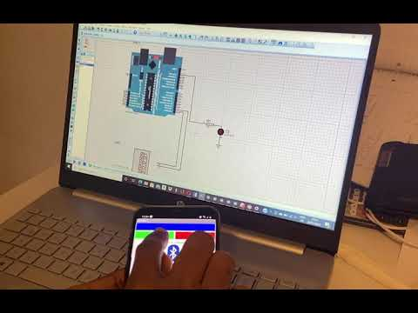
Bluetooth controlled LED Light (SIMULATION)
George Izuchukwu Enekwa

Slide 6
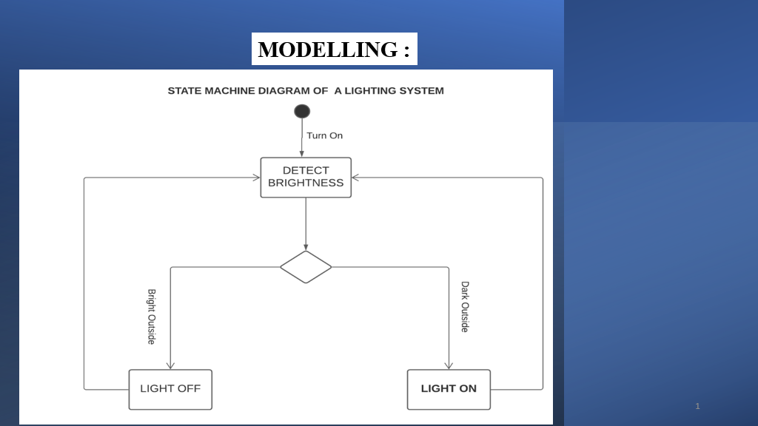
Giwa Habeeb Riwan

Slide 7
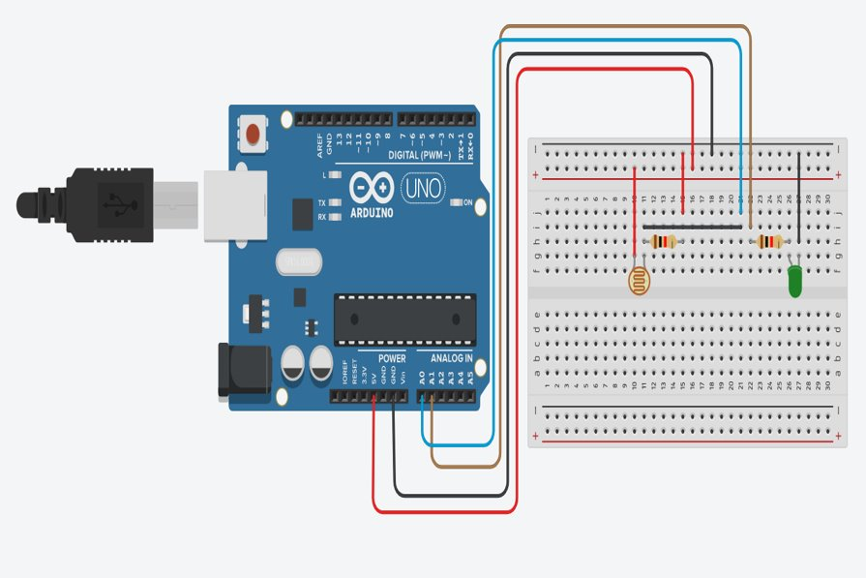
HARDWARE SETUP
Giwa Habeeb Riwan

Slide 8
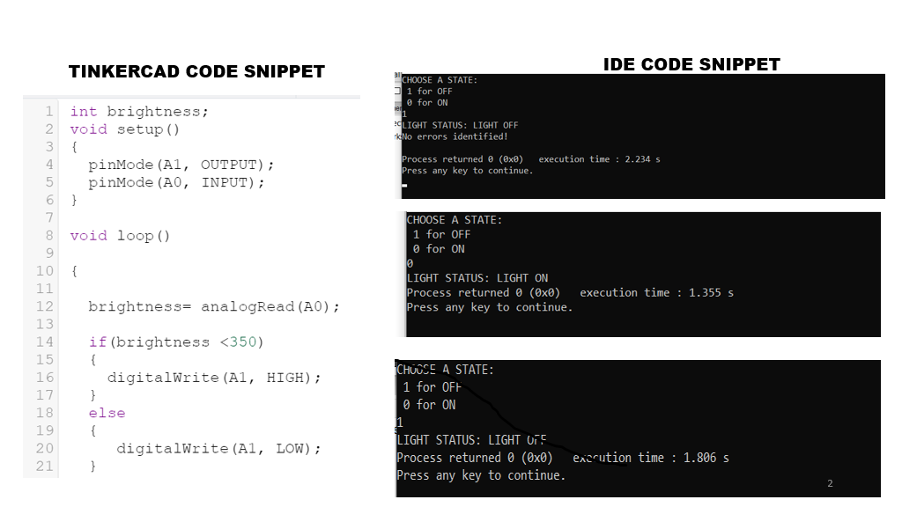

Slide 9
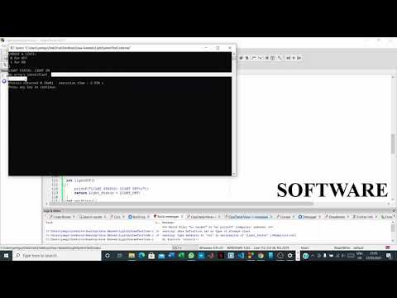

Slide 10
Features and characterics
Windows Blinds
Patrich Nonki
Page 10 - 14

Slide 11
Windows blinds
Mode based analysis
Class diagram
Sequence diagram
State machine diagram

Slide 12
Windows Blinds
Mapping from class diagram to code and test
Mapping from state machine diagram to code and test

Slide 13
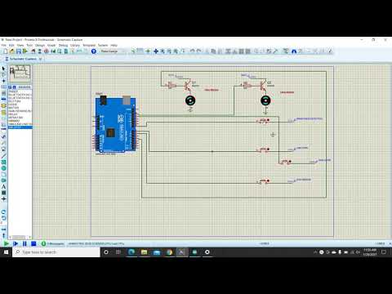
Windows Blinds
From code to ide (Arduino)
Simulation tool (Proteus professional
Simulation

Slide 14
Windows Blinds
Reliability and quality

Slide 15
Windows Blinds
Reliability over time and users
Ensuring real time improvement (Scrum working method)

Slide 16
THANK YOU….

